Slide 1
Transmission of motion and power
Prepared by: Guided by:
SHERATHIYA ANAND KANJIBHAI (130540106108) PROF. HIREN H. MAKWANA
BOPALIYA VIKAS (130540106014)
DEGAMA KISHANBHAI (130540106024)
GOTI SATISHKUMAR BHAGVANBHAI (130540106038)

Slide 2
Introduction
The mechanisms which are used to transmit the required motion and power from one shaft to another shaft are called mechanical drives.
These drives are extensively used in automobiles, workshops, processing and transport industry.

Slide 3
Types of mechanical drives
Belt and rope drives
Chain drives
Gear drives

Slide 4
Belt drives
Types of belts
(a) Flat belt
It is mostly used in factories and workshops, where a moderate amount of power is to be transmitted. The distance between two pulleys is not more than 8 meters apart.
(b) V –belt
It is mostly used in factories and workshops, where a moderate amount of power is to be transmitted. The distances between two pulleys are very near to each other.

Slide 5
(c) Circular belt or rope belt
It is mostly used in the factories and workshops, where a greater amount of power is to be transmitted. The distance between two pulleys is more than 8 meters.

Slide 6
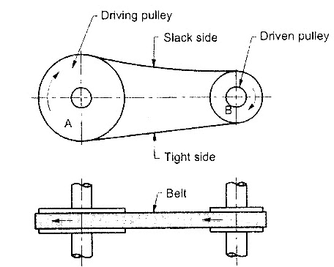
Open belt drive
Use
It is used when the driven pulley is to be rotated in the same direction as the driving pulley.
Construction
In this driving pulley pulls the belt on one side and drives it to the other side. So the tension on pulled side will be more than other side. The tension on pulled side is known as tight side and other side is known as slack side.

Slide 7
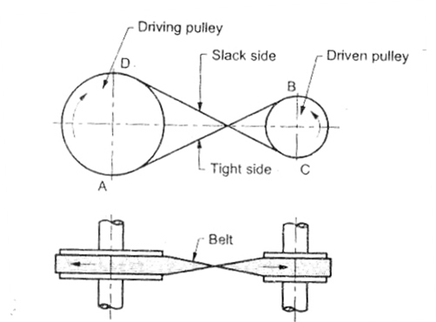
Crossed belt drive
Use
It is used when the driven pulley is to be rotated in the opposite direction to that of driving pulley.
Construction
In cross belt drive the belt bents in two different planes, it therefore wears more rapidly

Slide 8
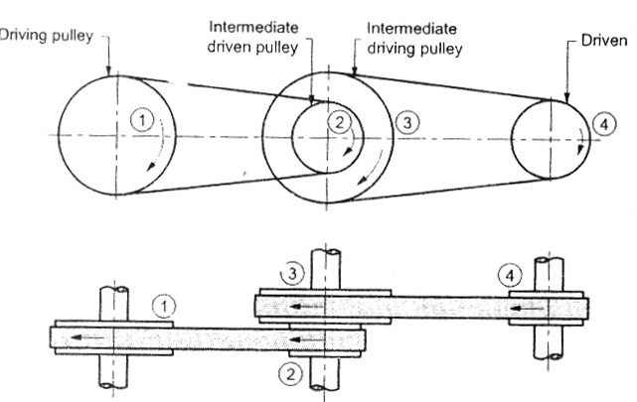
Compound belt drive
Use:
It is used when the distance between input and output shaft is very large.

Slide 9
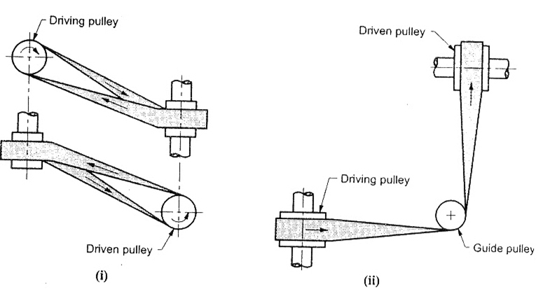
Quarter turn belt drive or Right angle belt drive
Use:
This belt drive is used when two shafts are at right angles and rotating in one direction only.
A guide pulley is used when motion is required in either direction.

Slide 10
Belt drive with idler pulleys
Construction
Material of belt is elastic due to which after prolonged use the belt is permanently stretched in length. This reduces the tension in the belt which leads to lower power transmission capacity.

Slide 11
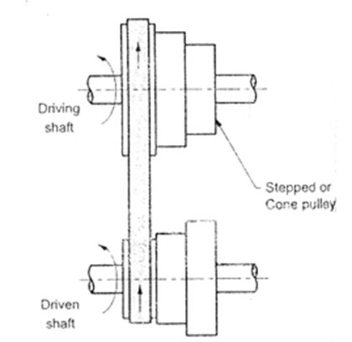
Stepped or Cone pulley drive
Use:
To run the driven shaft at different speed whereas the driving shaft runs at a constant speed through a motor.
Construction:
Both driving and driven pulleys has steps of equal radius so that the same belt can be used for varying the speed.

Slide 12
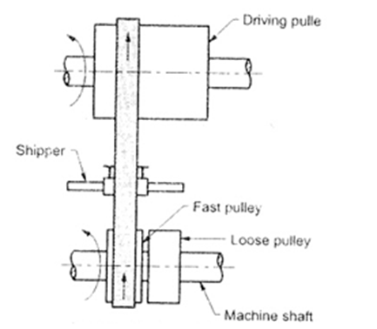
Fast and loose pulley drive
Use
Many times it is required to drive many machines from one driving shaft or main shaft. It is used to start or stop one machine without interfering other machines.

Slide 13
Rope Drive
Rope drives are widely used where a large amount of power is to be transmitted from one shaft to another shaft over a considerable distance.
Types of Rope Drives
(a) Fiber ropes
Made from fibrous material such as hemp, manila and cotton. Fiber ropes are used when shafts are about 60 meters apart.
(b) Wire ropes
Made from metallic wires. Wire ropes are used when shaft are about 150 meters apart. The wire ropes are used in elevators, mine hoists, cranes, conveyors etc.

Slide 14
Chain drive
Slipping occurs in belt and rope drives. In order to avoid this slipping phenomenon chain drives are used.
Construction
A chain drive consists of three elements driving sprocket, driven sprocket and an endless chain which is wrapped around two sprockets.
A chain consists of a number of links connected by pin joints, while the sprockets are toothed wheels and fit into the corresponding recesses in the links of the chain.

Slide 15
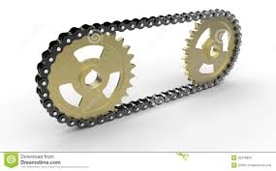
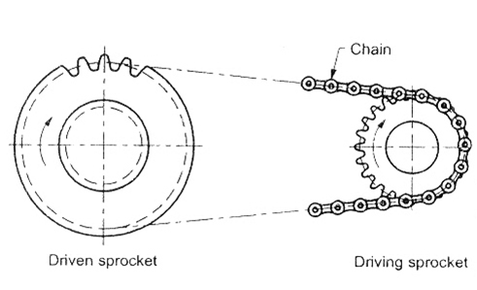
A chain drive consists of three elements driving sprocket, driven sprocket and an endless chain which is wrapped around two sprockets.
A chain consists of a number of links connected by pin joints, while the sprockets are toothed wheels and fit into the corresponding recesses in the links of the chain.

Slide 16
Methods of drive
There are basically two methods of drive.
Individual drive
Group drive

Slide 17
Individual drive
In this system, each machine tool has its own electric motor which drives the machine through belt, chain, gearing or by direct coupling. The system is also called as self contained drive.
Advantages
Individual machines can be run and stopped at operator will.
System is simple and compact.
Failure of motor affects the working of a particular machine only without affecting the working of other machines in the workshop.
Overhead cranes can be installed.
Lighting of the workshop is not affected by belts and overhead shafts.

Slide 18
(B) Group drive
The main shaft runs across the workshop from one end to other end. The main shaft drives another shaft called counter shaft. Finally the countershaft drives the group of machines through belting. The countershaft also carries cone pulleys to give wide range of speeds.
Advantages
It is suitable when all machines are required to run simultaneously. It reduces the size of the motor required.
The initial capital investment is low.
A set of cone pulleys give wide range of speed.
It will be more economical when utilization factor is high.
Maintenance is easy.

Slide 19
Elements of power transmission
The main elements of power transmission system are,
The nuts, bolts, pins, keys and couplings, etc. are provided to hold the two components of machine elements together.
Driving and driven shafts.
Belts, chains, gears are as connectors for transmission of motion and power from driving to driven shaft.
Axles, bearings, brackets etc. to provide support to other elements of a machine.

Slide 20
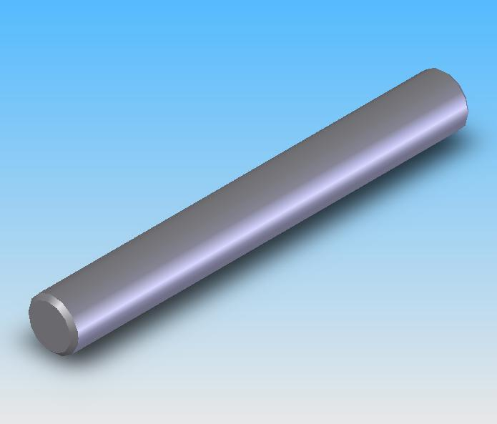
Shaft
A shaft is a rotating machine element which transmits power.
The power is delivered to the shaft by the application of tangential force and the resulting turning moment set up in the shaft allows the power to be transmitted from one point to another point.

Slide 21
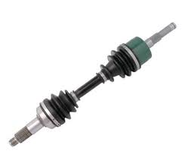
Spindle
A spindle is a short revolving shaft that transmits motion either to a cutting tool or a work piece.
Axle
An axle is machine element which is used for transmitting bending moment and carries such rotating parts as wheels and gears. An axle may be stationary or it may be rotating.

Slide 22
Gear drive and friction drive
Advantages
It is a positive drive (no slip) i.e. it transmits exact velocity ratio from one shaft to another shaft.
It can transmit very large power.
High transmission efficiency.
Requires less space.
Reliable.

Slide 23
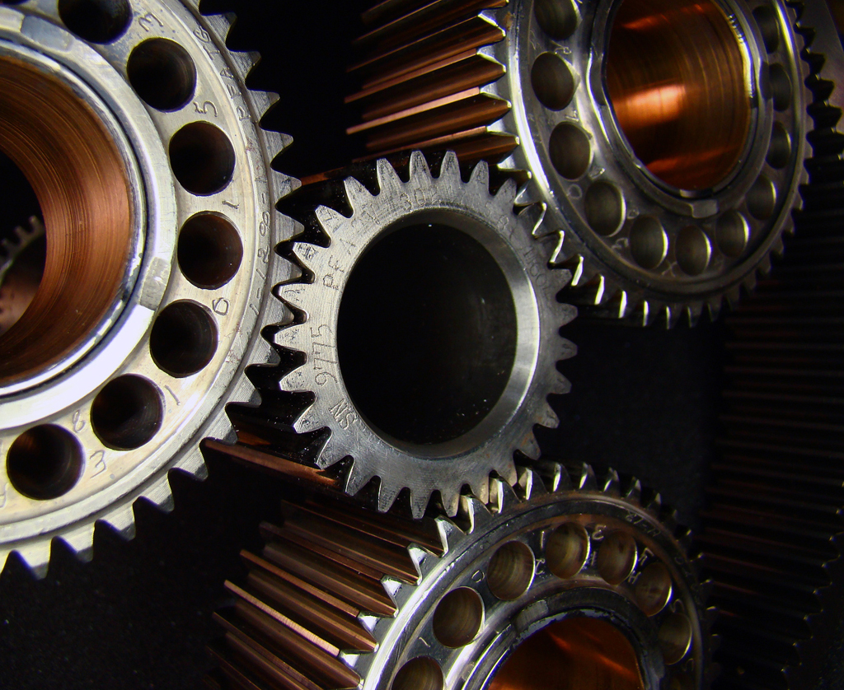
In order to transmit a definite power from one shaft to another shaft to the projection on one disc and recesses on another disc can be made which can mesh with each other. This leads to the formation of teeth on both discs and the discs with teeth on their periphery are known as "Gears".

Slide 24
Classification of gears

Slide 25
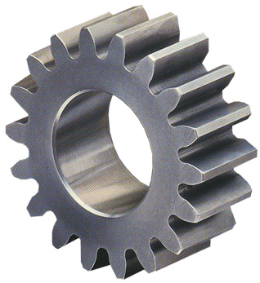
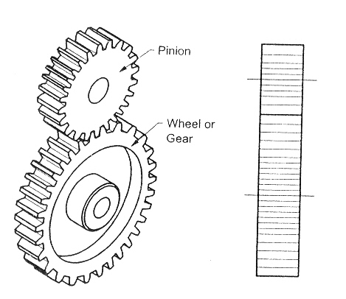
Spur gear
Use:
When the axis of two shafts are parallel to each other. These gears have teeth parallel to the axis of the shaft.

Slide 26
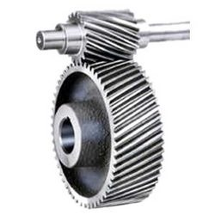
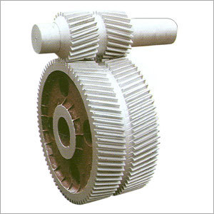
Helical gear
In helical gears the teeth are at some angle called helix angle with respect to axis of the shaft.

Slide 27
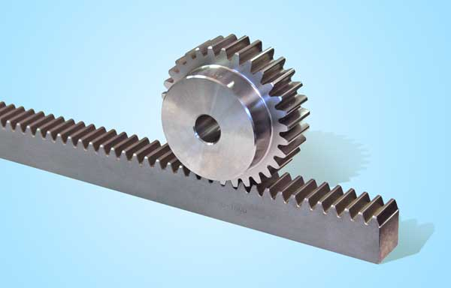
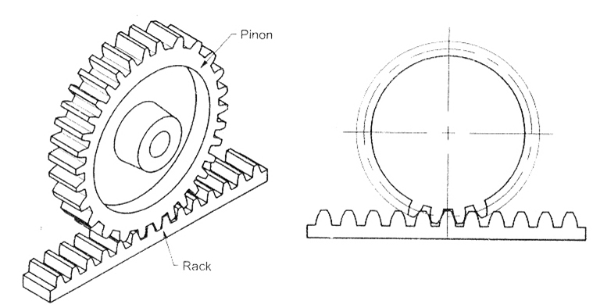
Rack and pinion
It is a special case of spur gear in which one gear is having infinite diameter called "Rack".
Use
To transmit the rotary motion into reciprocating motion or vice-versa.
Application
Lathe machine, drilling machine and measuring instrument.

Slide 28
Bevel gear
Use
When power is required to be transmitted from one shaft to another shaft which are intersecting to each other then bevel gears are used. Generally, the angle between two shafts is 90⁰.
The bevel gears are of two types,
Straight bevel gear
Spiral bevel gear

Slide 29
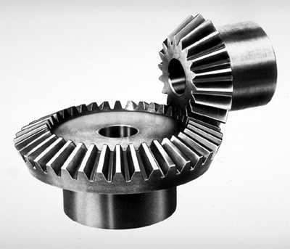
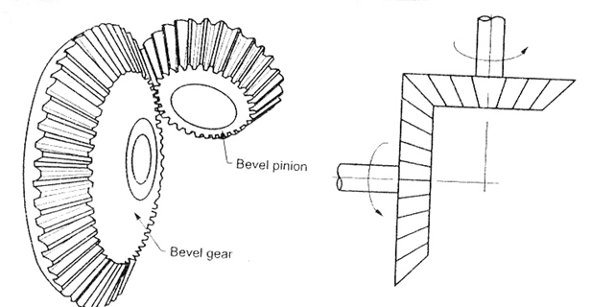
Straight bevel gears
In straight bevel gears the teeth are formed straight on the cones, and they are parallel to the axis of the gear

Slide 30
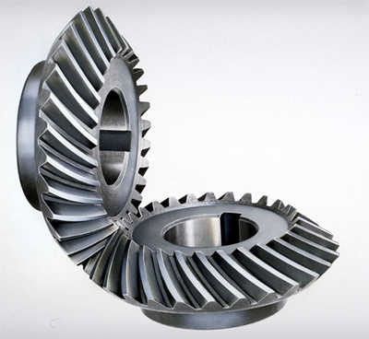
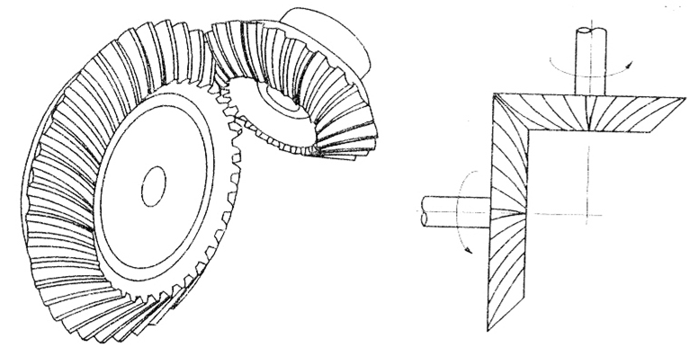
Spiral bevel gears
In a spiral bevel gear, the teeth are formed at an angle with respect to its axis. The contact between two meshing teeth is gradual and smooth from start to end, as in case of helical gears.

Slide 31
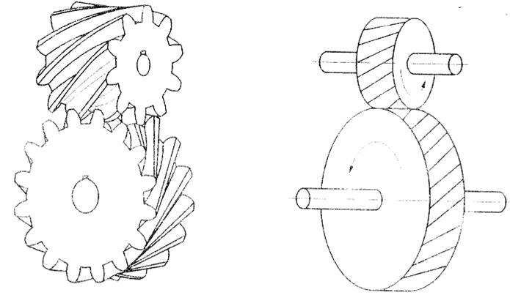
Spiral Gears (Skew gears or Crossed helical gears)
Use
To transmit power from one shaft to another shaft which are non parallel and non intersecting.
For low load transmission only since they have point contact between mating teeth.

Slide 32
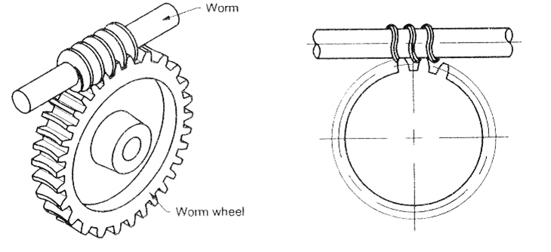
Worm and worm wheel
Use
To transmit power from one shaft to another shaft which are non intersecting and their axes are normally at right angles to each other.
Application
Lathe machine to get large speed reduction.

Slide 33
Thank you….

